Slide 1
How to Boost Summer Learning
Keeping Your Kids Learning This Summer

Slide 2
What Do We Know About Summer Learning Loss?
On average students lose one month of learning over the summer months.
Losses are higher for math as compared to reading.
Higher grade levels experienced more loss that lower grade levels.
52% of students lose an average of 39% of their total school year gains during the summer months.

Slide 3
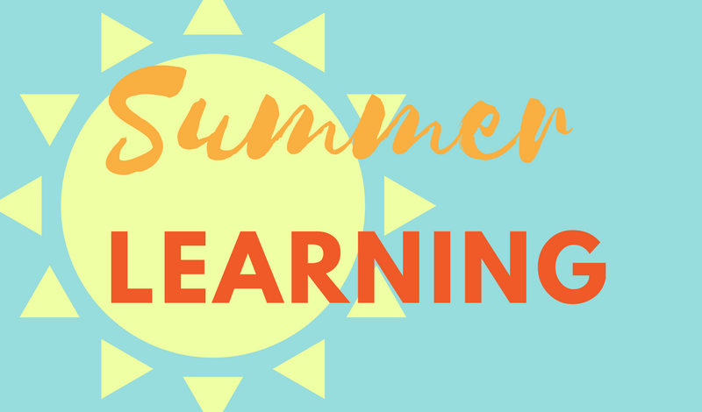
The highest priority for students this summer must be promoting and supporting their mental health and well-being and providing learning opportunities grounded in student interests that can ignite and renew engagement and foster learning.

Slide 4
Why Summer Learning Is Important This Year
Summer learning has the potential to help students re-acclimate and rebuild their academic and social identities so that they're positioned for a strong start in what will hopefully be a much more familiar 2021-22 school year.
This summer will be crucial for catching up students who may have fallen behind due to the pandemic.
Summer learning is going to be essential to closing the gaps that you may see with your kids.

Slide 5
What is Well-Rounded Summer Learning?
Individualized: Personalized strategies for meeting individual needs as identified by school assessments and building student academic performance.
Intentional: Activity planning and execution must reflect intentional focus on meeting learning needs and providing hands-on, experiential, project-based, social justice-themed, and culturally relevant activities that will foster student growth is critical.
Integrated: Activities that build skills, knowledge, and behaviors that promote academic success and healthy development.

Slide 6
Summer Activities To Involve the Family
Ask kids to create their own board games. Let them choose something they love (i.e. dogs, cooking, Disney, soccer, etc.), and challenge them to design a board game around their passion. From creating the game board and researching their topic to figuring out the rules and writing simple directions for others to follow, this hands-on activity truly puts the fun in learning.
Plan "surprise adventures." Think outside the typical tourist spots for these family field trips. Look for Revolutionary or Civil War re-enactments (Greater Williamsburg, Virginia played a prominent role in both wars and has several battlefields to explore). Or factory tours, Renaissance festivals, historic home tours, jazz concerts, ethnic festivals, botanical gardens, county fairs, living history farms, planetariums, animal sanctuaries, historic battlefields, lighthouses, and working ranches.
Teach with movies! After watching a movie together, go beyond "Did you like the movie?" and talk about the movie's themes, such as respect, friendship, or kindness. Ask your kids why they think the characters chose a certain action or what the characters could have done differently for a better outcome. Challenge them to come up with an alternate ending.
Teach your kids how to play chess. Once your kids master the basics, sign them up for a chess club. "Chess trains your brain to think critically—to discover like a scientist, create like a technician, innovate like an engineer, and problem solve like a mathematician," explains Wendi Fischer.

Slide 7
Summer Activities To Involve the Family
Declare a weekly "Kids in the Kitchen" day. Get kids baking cookies, and have them double the recipe to help brush up on math skills. Invite them to read through your cookbook, find a dinner recipe, and write a grocery list of ingredients. As they shop with you, help them compare prices, look at price-per-unit, and calculate coupon savings. At home, prepare the meal together as they read, measure and follow directions.
Get kids reading any way you can, including comic books, magazines, graphic novels, almanacs, joke books, recipes, game instructions, movie reviews, poems, restaurant menus, product descriptions, sports statistics, and song lyrics. And don't overlook the value of listening to audiobooks; they can introduce kids to books above their reading level and teach critical listening and introduce new vocabulary, among other benefits.
Encourage building for both boys and girls. Don't toss those blocks once your toddlers reach school age. Even older kids benefit from the process of building a structure because it involves motor skills, creativity, hand-eye coordination, critical thinking, math skills, problem-solving, and spatial awareness. UseLegos, Keva Planks, CitiBlocs, Magna-Tiles, K'NEX, Tinkertoys, Erector sets, gears, and marble mazes. On the use-what-you've-got-at-home side, repurpose cardboard boxes, cardboard spools (from paper towels, bathroom tissue and gift wrap), toothpicks, craft sticks, and PVC pipe.
Fuel your kids' passions. Whether they're into astronomy, U.S. presidents, music, horses, magic, gymnastics, or science, find age-appropriate ways to feed their interests with books (fiction and non-fiction), magazines, supplies, documentaries, performances, games, activities, field trips, websites, classes, and clubs.

Slide 8
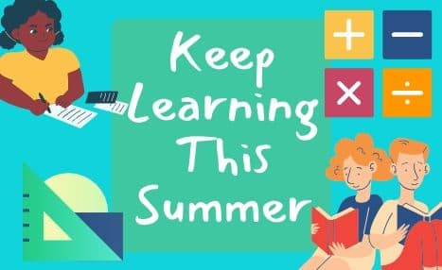
Ideas for Active Summer Learning
Build reading and writing into everyday activities.
Encourage writing.
Be an active citizen.
Active bodies. Active minds.
Watch a garden grow.

Slide 9
Family Reading Activities
Have an electronics-free hour each day when everyone reads
Encourage kids to research fun topics they want to learn about
Take turns reading pages/books aloud
Challenge children to a summer read-a-thon with small rewards or prizes for each book read or for reaching a certain number of books read
Remind kids to consider nonfiction books when learning how to do something new such as building a birdhouse, sewing, fixing a car, or caring for animals, among other fun and useful skills

Slide 10
Games to Make Learning Fun
Use Skittles or other small candies as manipulatives while practicing multiplication or division.
Practice math facts at the pool: kids retrieve two numbered diving sticks and add or multiply their numbers.
Have kids take turns playing the banker in Monopoly or adding up scores for Uno or other number-based card games.
Practice spelling and vocabulary by playing Scrabble.
Entertain younger children on car rides by asking them to read road signs or count all the cows or yellow cars they see.

Slide 11
By sneaking education into fun activities, you'll keep your kids "accidentally" learning all summer long!

